Slide 1

KINGS GOLDEN FUTURE
Bridging AI Computing Power with Real-World Physical Assets
A Decentralized Physical Infrastructure Network (DePIN) generating sustainable, cash-backed daily yields and quarterly profit distributions across AI computing nodes and a 10-project RWA ecosystem.
100% Guaranteed
5% Global Pool
60-Mo HNW / 24-Mo Core
INVESTOR CAPITAL RETURN
QUARTERLY PROFIT SHARING
INFRASTRUCTURE LIFESPAN

Slide 2
EXECUTIVE OVERVIEW
KGF At A Glance: The Dual-Engine Infrastructure
High-level synthesis of our value proposition, market positioning, and investment opportunity.
1. The Core Vision
2. High-Yield Tokenomics
• Pioneering the convergence of AI Computing Hardware with Real-World Physical Assets (RWAs).
• Eliminating speculative crypto volatility by anchoring daily yields to physical cash-generating utilities (Alkaline Hydrogen Water, Vending, EV).
• Dual-engine growth: Digital yield generation meets physical distribution franchises.
• Proprietary 3-Wallet Dynamic Balancing: 0.8 Static (KGF) + 1.2 Earning (USDT) + 1.0 Utility (HGN).
• 1% Daily Yield output on standard Hydrogen Computing units (300 USDT).
• Self-sustaining ecosystem funded by 35 USDT/mo Data Storage Box recurring subscriptions.
3. High-Net-Worth Investor Tiers
4. Physical Franchise Network
• Dedicated institutional & angel tiers: Golden ($3K), Diamond ($5K), Platinum ($10K).
• 100% Capital Return upon completion of a structured 60-month operational lifecycle.
• Direct participation: 5% shared from company global ecosystem profits disbursed on a calendar quarterly basis.
• Rapid community expansion via K1A through K6A tiered leadership ranking.
• Physical Distributor Centers (DC) serving local territories with alkaline water distribution.
• Saturday liquidity settlement windows with controlled reserve ratios to guarantee liquidity health.

Slide 3
MARKET OPPORTUNITY
The Structural Gap in Web3 & Infrastructure Investment
Current market offerings force investors to choose between volatile speculation and low-yield traditional assets.
⚠️
⚡
🏢
🛡️
The Speculative Trap in Crypto
AI Compute Scarcity & Bottlenecks
Illiquid Real-World Assets (RWAs)
Zero Capital Protection for Angels
95% of Web3 projects lack real-world utility, physical cash flow, or capital preservation mechanisms, leading to extreme liquidity vulnerability and loss of capital.
Hyper-demand for AI and data processing infrastructure is skyrocketing, but centralized data centers suffer from high power costs, localized grid strain, and access barriers.
High-margin physical businesses (vending, clean water, clean energy, EV fleet) are locked away in illiquid, capital-intensive silos inaccessible to everyday and angel investors.
Early-stage investors typically risk 100% loss with no liquidity timeline, no structured capital return, and no transparent automated dividend disbursement.
Market Takeaway: High-Net-Worth and Institutional capital requires a hybrid model: High-yield tech returns + physical RWA cash flows + guaranteed capital return.

Slide 4
THE SOLUTION
The KGF Dual-Engine Infrastructure Model
Harmonizing digital computational capacity with high-velocity physical revenue streams.
ENGINE 1: DIGITAL INFRASTRUCTURE
ENGINE 2: PHYSICAL ASSETS (RWA)
Hydrogen Computing Power & Data Storage
Real-World Asset Deployment & Franchises
• Distributed AI Computing: Modular 300 USDT compute nodes delivering 1% daily return.
• Recurring Cloud Revenue: Mandatory 35 USDT/mo Data Storage Box sustains continuous corporate reserves.
• Automated Cron Rebalance: Zero downtime; retroactive yield reconciliation algorithm.
• Alkaline Hydrogen Water Vending: Physical distribution centers redeeming 1 HGN for 5L daily wellness water.
• 10-Project RWA Pipeline: Expanding into EV charging hubs, vehicle rentals, solar estates, hygiene tech.
• Tangible Collateral: Every tokenized yield is backstopped by operating hardware and franchise inventory.
THE KGF SYNERGY: Computational yield funds physical asset expansion — Physical asset cash flows backstop token liquidity & investor profits.

Slide 5
MARKET SIZE
Trillion-Dollar Macro Tailwinds
Positioned at the intersection of three highest-growth global mega-trends.
$16.1T
$1.3T
$418B
RWA Tokenization Market
Generative AI & Compute Boom
Clean Hydrogen & Functional Water
Boston Consulting Group (BCG) by 2030
Bloomberg Intelligence Forecast
Grand View Research / Frost & Sullivan
Real-World Asset tokenization is projected to capture 10% of global GDP by 2030, transforming real estate, energy, infrastructure, and physical franchises into liquid high-yield assets.
Surging demand for decentralized computing power, high-performance computing clusters, and low-latency edge computing infrastructure required by enterprise AI applications.
Explosive consumer shift towards cellular micro-hydration, alkaline wellness, and zero-emission green hydrogen technologies across commercial vending and residential sectors.

Slide 6

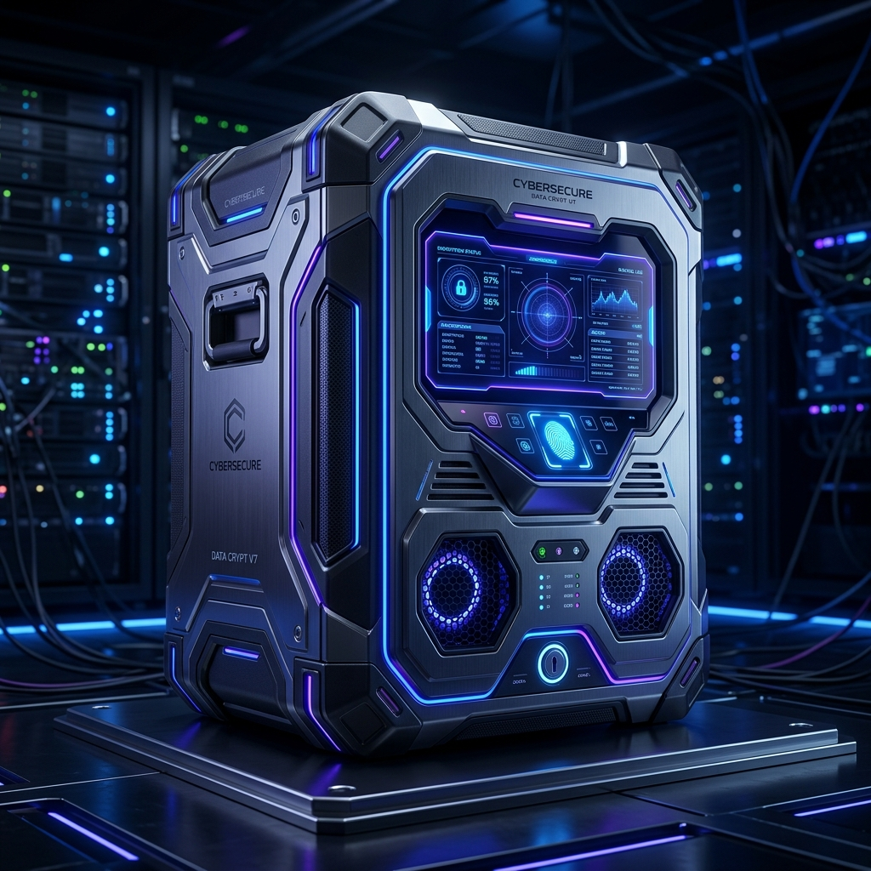
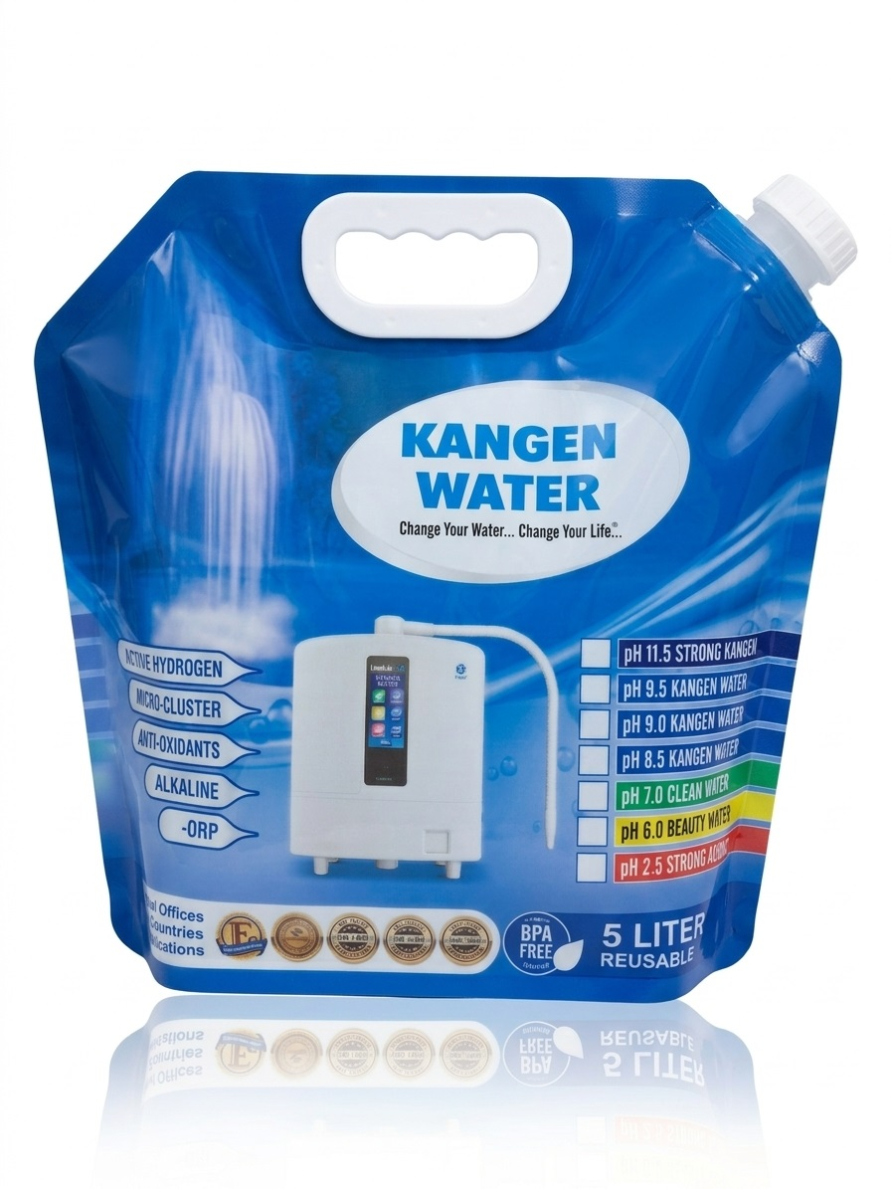
PRODUCT ECOSYSTEM
Proprietary Hardware & Subscription Products
Commercial products powering user participation, ongoing cashflow, and physical utility.
Hydrogen Computing Power
Data Storage Box
Alkaline Hydrogen Water (5L)
300.00 USDT
35.00 USDT / Month
1 HGN Token (5.00 USDT)
• 12 Months deployment on 24 Months return cycle.
• 1% Daily Yield output (3.0 USDT/day).
• Proprietary AI Data Mining algorithm with retroactive catch-up logic.
• Mandatory cloud ledger maintenance fee.
• Auto-renewed seamlessly from Earning Funds.
• Enforces strict network health & active participant compliance.
• Active Hydrogen-rich alkaline water (-ORP).
• Deep cellular micro-hydration in 5L carry packs.
• Daily redemption from local certified Distributor Centers (DC).

Slide 7
ECONOMIC MODEL
The 3-Wallet Dynamic Balancing System
Mathematical precision dividing the daily 3.0 USDT yield to ensure perpetual network liquidity.
Daily Compute Yield: 1.0% of 300 USDT = $3.00 USDT / Day (Automated Algorithm)
1. STATIC FUNDS (KGF)
2. EARNING FUNDS (USDT)
3. UTILITY FUNDS (HGN)
0.8 USDT / Day
1.2 USDT / Day
1.0 USDT / Day
26.6% Allocation
40.0% Allocation
33.3% Allocation
• Locked long-term capital reserve token (KGF).
• 24-Month lock ensures continuous project liquidity retention.
• Non-inflationary asset backed by computational expansion.
• Subject to 3-month storage compliance governance.
• Liquid, on-chain BEP-20 USDT withdrawable to user wallets.
• Multiples of $10 with minimum withdrawal of $10 USDT.
• 5% fee for first 3 monthly withdrawals; 10% thereafter.
• Zero-fee peer-to-peer (P2P) internal transfers.
• Tokenized utility pegged at 1 HGN = 1 USDT.
• Redeemable daily for 5 Liters of fresh Alkaline Hydrogen Water.
• Distributor Centers claim HGN for USDT at 1:0.5 on Saturdays.
• Optional opt-out reroutes 50% into corporate reserve pools.

Slide 8
INVESTOR TIERS
High-Net-Worth & Institutional Participations
Premium institutional capital opportunities featuring guaranteed capital return and quarterly profit sharing.
ENTRY INSTITUTIONAL TIER
MOST POPULAR STRATEGIC TIER
ELITE ENTERPRISE TIER
GOLDEN PARTICIPANT
DIAMOND PARTICIPANT
PLATINUM PARTICIPANT
$3,000 USDT
$5,000 USDT
$10,000 USDT
Duration:
60 Months
Duration:
60 Months
Duration:
60 Months
Capital Return:
YES (100% Guaranteed)
Capital Return:
YES (100% Guaranteed)
Capital Return:
YES (100% Guaranteed)
Profit Sharing:
5% Global Pool (0.25% Share)
Profit Sharing:
5% Global Pool (0.35% Share)
Profit Sharing:
5% Global Pool (0.50% Share)
Disbursement:
Calendar Quarterly
Disbursement:
Calendar Quarterly
Disbursement:
Calendar Quarterly
Token Swaps:
KGF Rewards from HGN
Token Swaps:
KGF Rewards from HGN
Token Swaps:
KGF Rewards from HGN
Key Safeguard: HNW investors participate directly in real corporate EBITDA distributions with fully guaranteed principal repayment.

Slide 9
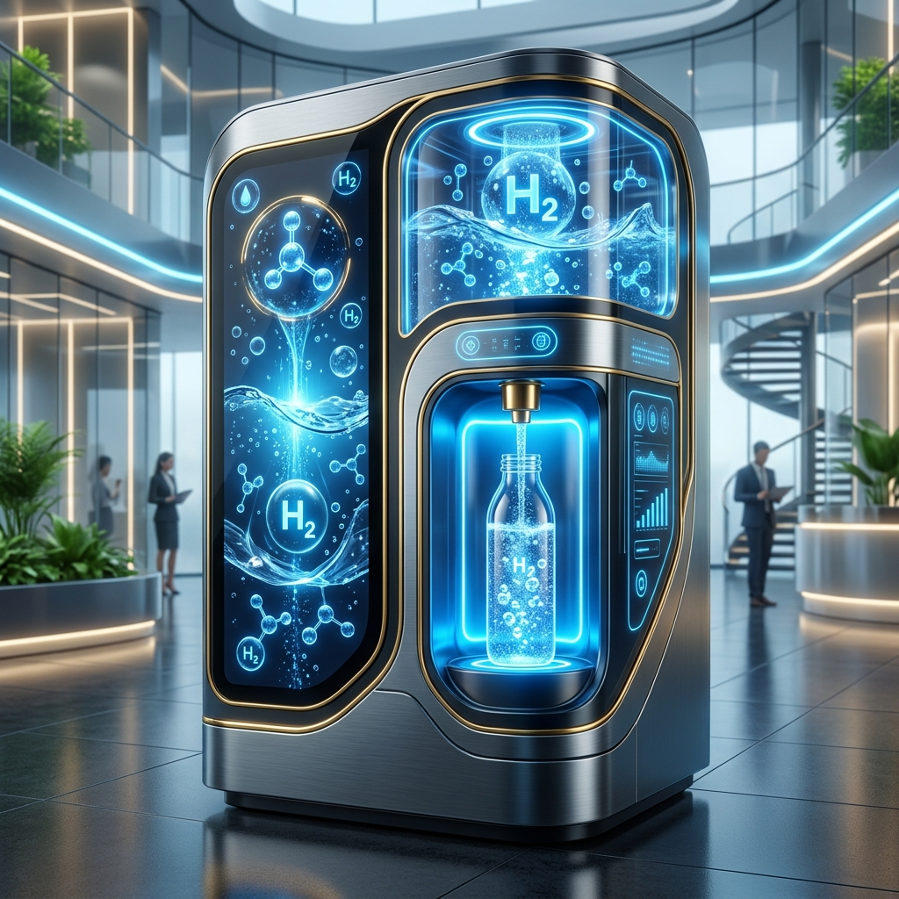
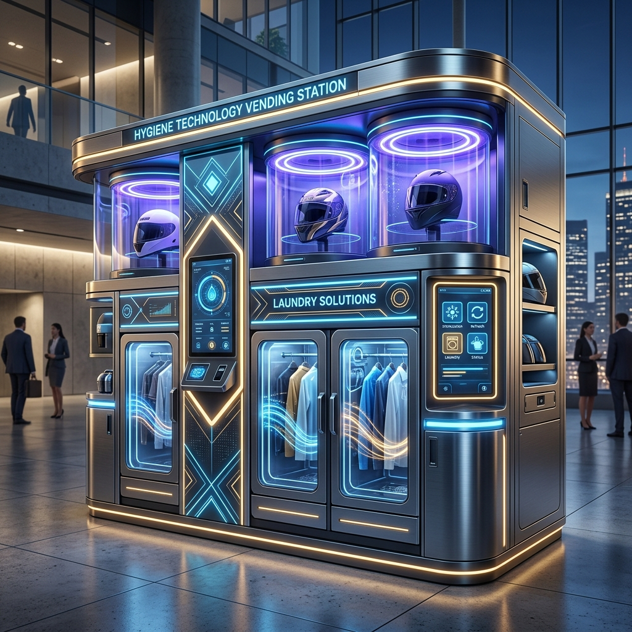

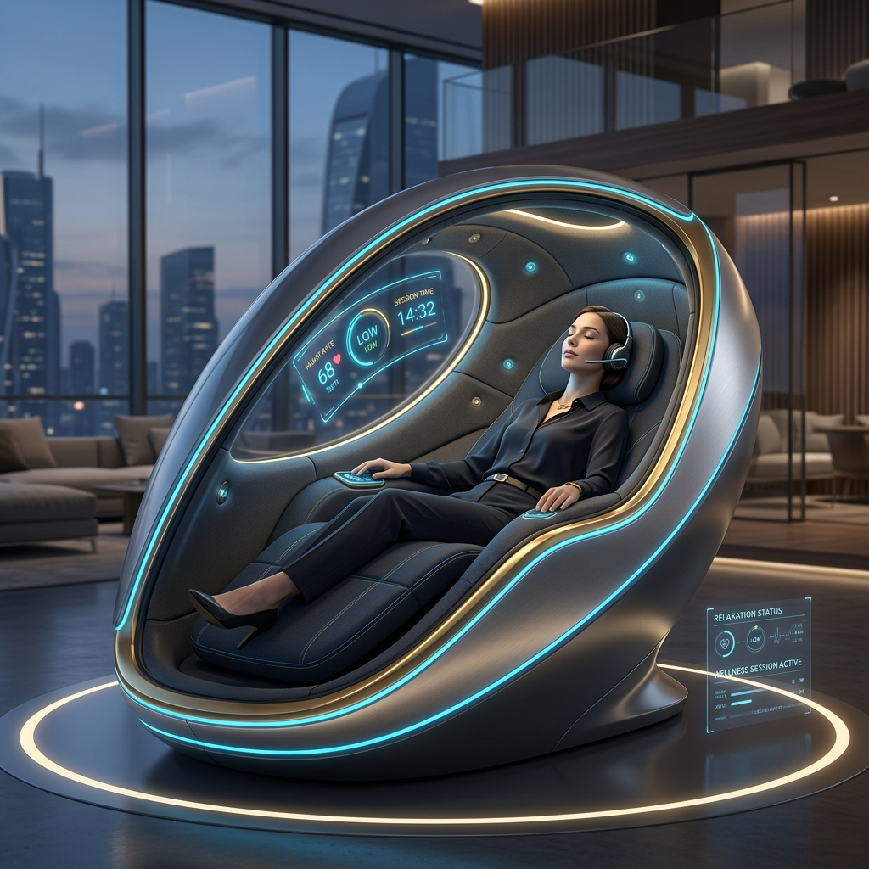
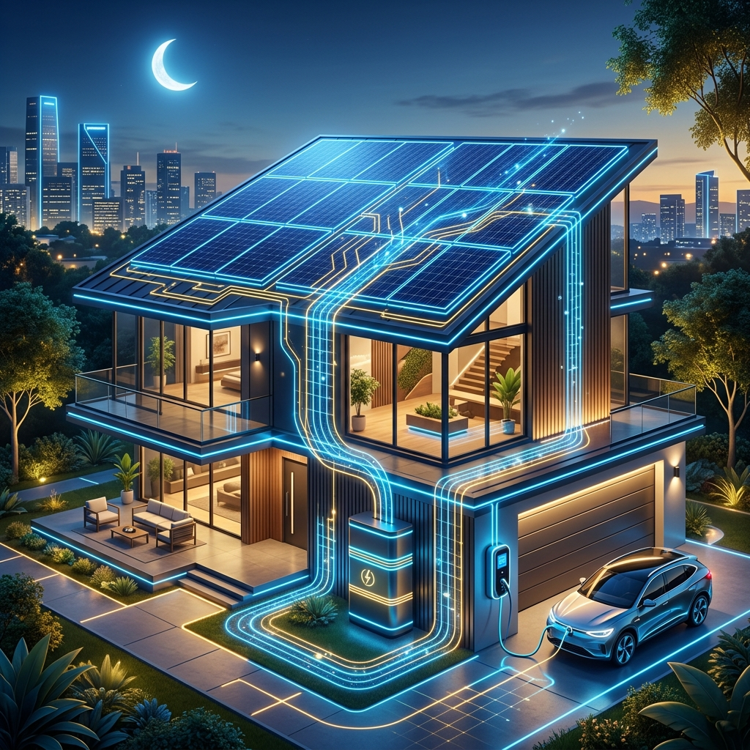
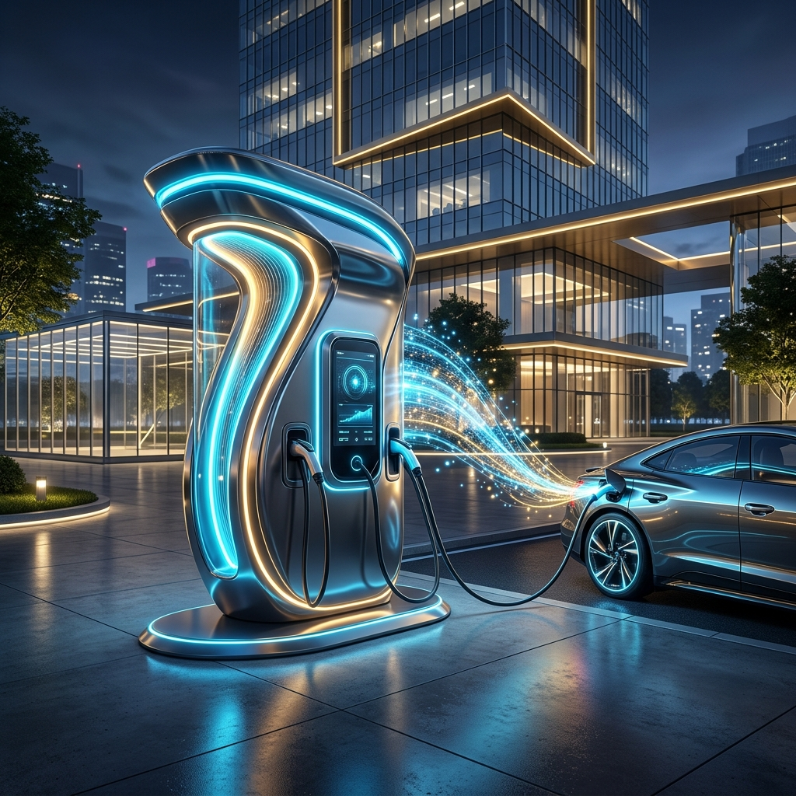
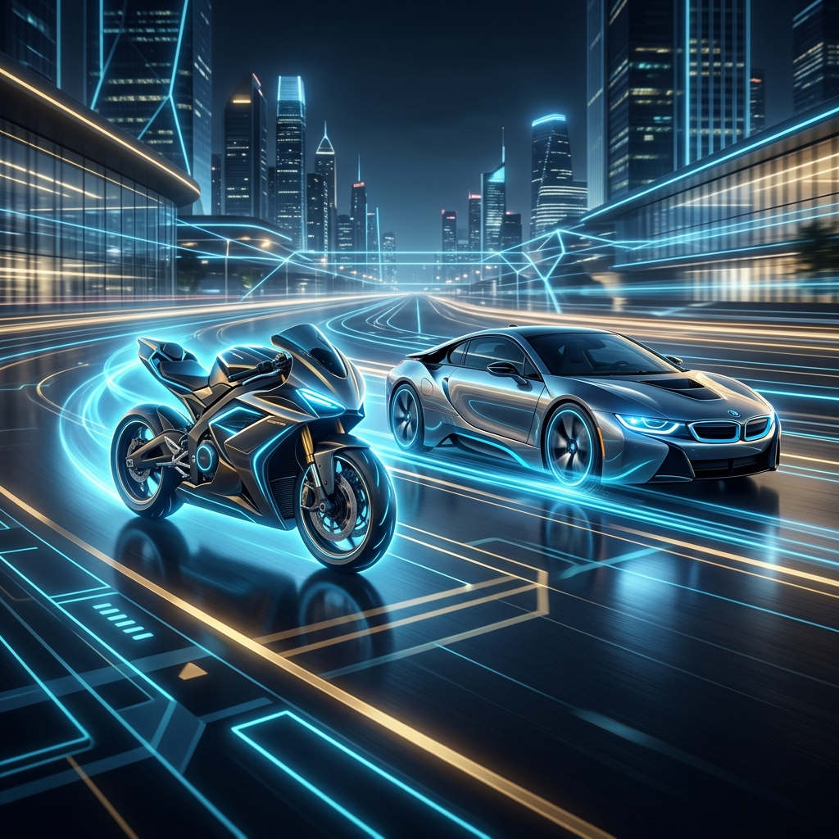
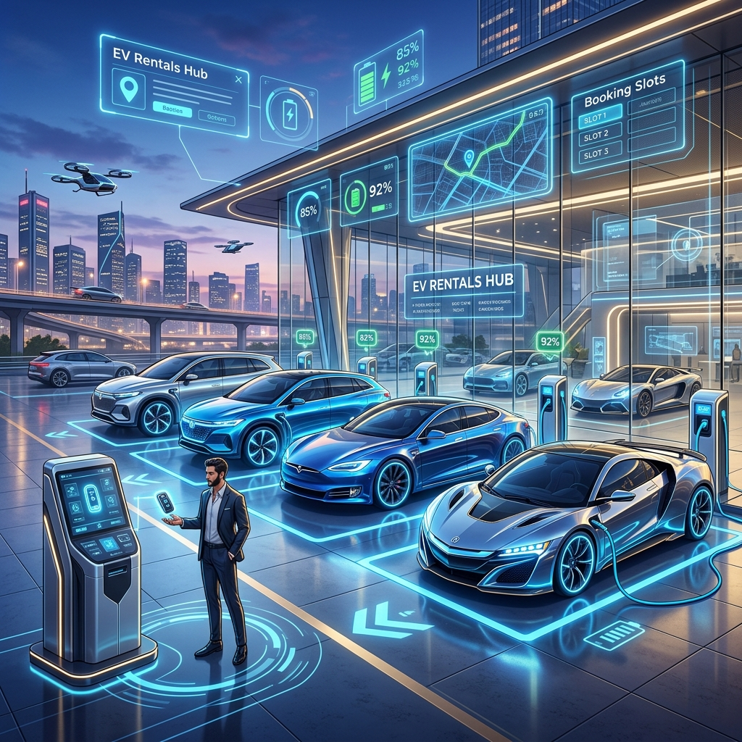
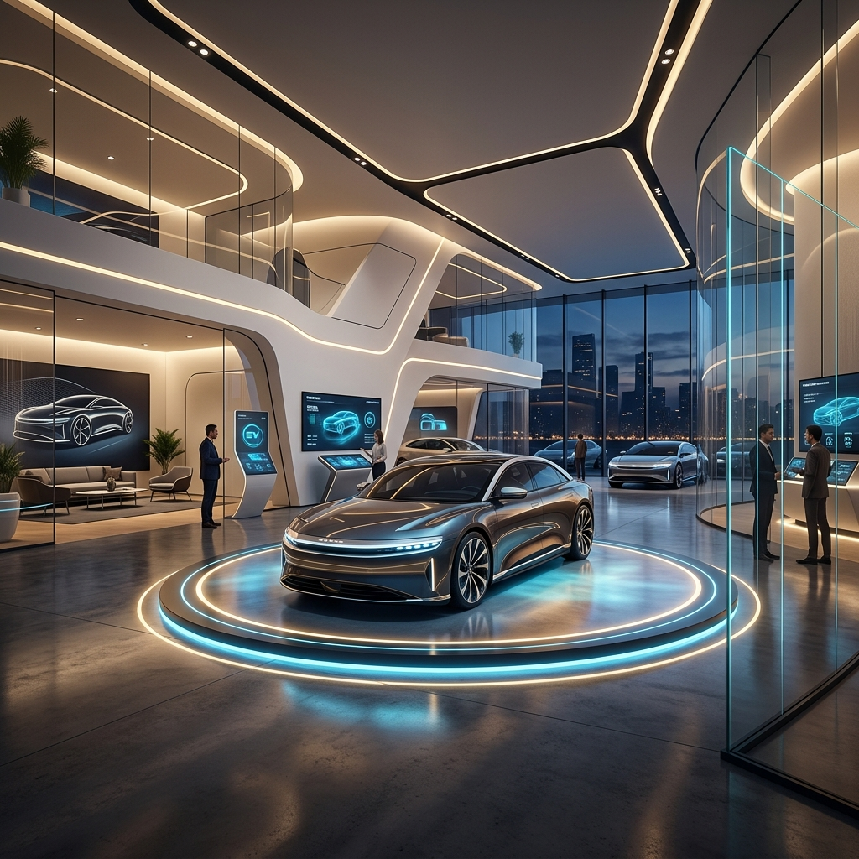
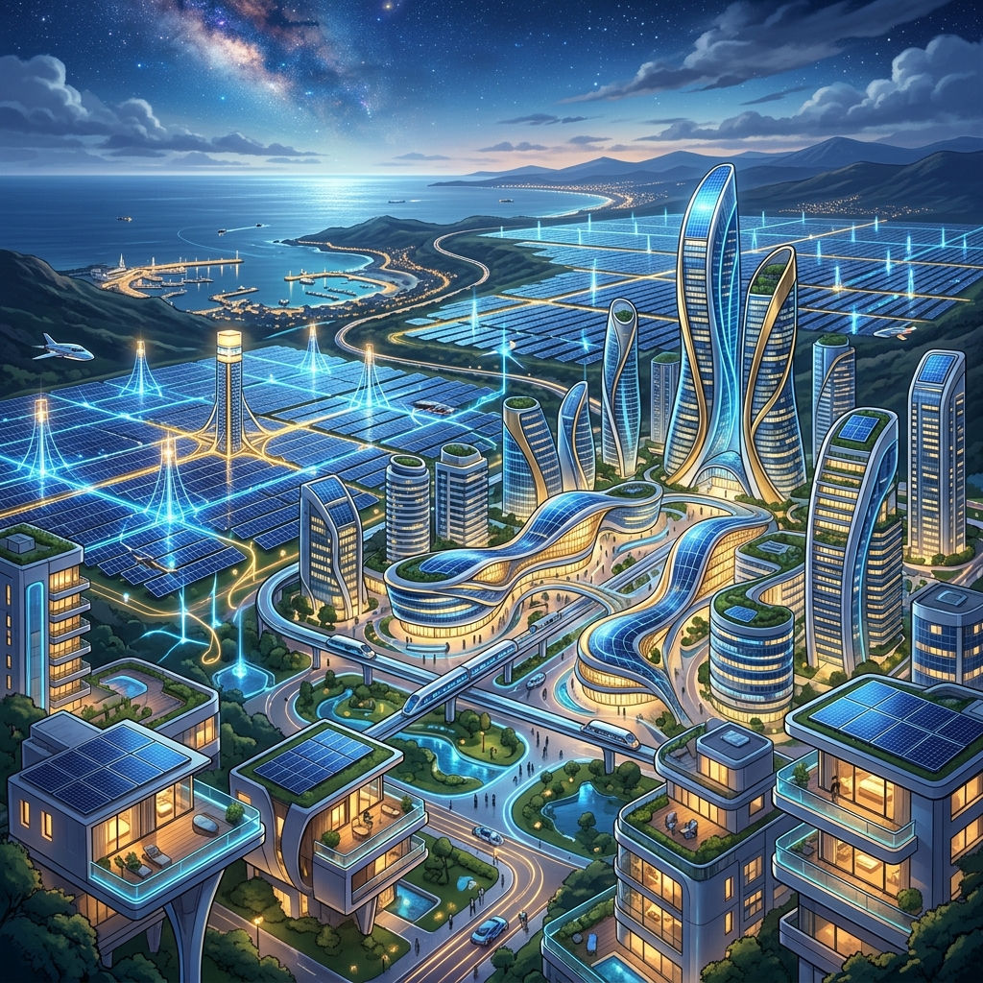
REAL-WORLD ASSETS
The 10-Project Physical Asset Pipeline
Tangible cash-flow generating infrastructure scaling across regional and global markets.
01
ONGOING
02
UPCOMING
03
ON WORKING
04
PIPELINE
05
PIPELINE
Hydrogen Water Vending Tech
Hygiene & Laundry Vending
AI-Based IT Data Centers
Relaxing Wellness Pods
Domestic Solar Tech Systems
06
PIPELINE
07
PIPELINE
08
PIPELINE
09
PIPELINE
10
PIPELINE
EV Charging Station Hubs
EV Commercial Bikes & Cars
EV Vehicle Rental Fleet
Tesla Car Dealership Center
Utility Solar Plant Estate
Diversified Cash Flows: RWAs provide independent revenue independent of crypto market cycles.

Slide 10
DISTRIBUTION NETWORK
Decentralized Physical Franchise Model
High-velocity grassroots distribution combining MLM leadership incentives with physical retail franchises.
K1A – K6A LEADERSHIP COMMISSION POOL
DISTRIBUTOR CENTRES & ENTERPRISE REWARDS
From each 300 USDT computing package, 20% (60 USDT) is allocated to the team rewards pool. 1 Point = 7.5 USDT.
Distributor Centre (DC = K6A)
Reward: Commercial Hydrogen Machine
100 Active User Subscriptions
K1A
1 Direct Sale
7.5 USDT (1 Pt)
K2A
2 – 10 Team
15.0 USDT (2 Pts)
Master Distributor (MD)
Reward: $3,000 USDT Mining Machine
10 Qualified Distributor Centres
K3A
11 – 20 Team
22.5 USDT (3 Pts)
K4A
21 – 50 Team
30.0 USDT (4 Pts)
Zone Distributor (ZD)
Reward: $5,000 USDT One-Time Car Fund
25 Master Distributors Network
K5A
51 – 100 Team
37.5 USDT (5 Pts)
K6A
101+ Team
45.0 USDT (6 Pts)
State Distributor (SD)
Reward: $10,000 USDT One-Time Home Fund
10 Zone Distributors Network

Slide 11
UNIT ECONOMICS
Diversified Corporate Revenue Engines
Multiple recurring, non-correlated income channels driving company profitability.
1. AI Compute Yield Margin
35% of Revenue
Hardware arbitrage margin between enterprise wholesale AI computing revenues and the 1% daily yield distributed to participants.
2. Cloud Data Storage Fees
25% of Revenue
Continuous monthly inflow of 35 USDT per participant box. A network of 10,000 units generates $350,000/month in pure recurring software maintenance.
3. Physical Water & Vending
20% of Revenue
High gross-margin physical retail water sales. DC settlement spread: 1 HGN redeemed at 1 USDT retail vs. 0.50 USDT wholesale admin settlement.
4. Dynamic Withdrawal Fees
10% of Revenue
Automated 5% transaction fee on standard cashouts escalating to 10% on 4th+ monthly withdrawals preserves cash and supplies corporate reserves.
5. RWA Energy & EV Assets
10% of Revenue
Commercial charging station tariffs, EV fleet lease revenues, and residential solar installation contracts.
Financial Result: A robust, multi-pillar revenue model supporting continuous investor quarterly returns.

Slide 12
SECURITY & GOVERNANCE
Institutional-Grade Security & Risk Mitigation
Multi-layer protocols protecting participant funds, system integrity, and regulatory compliance.
🔐 Dual-Password Security
⛓️ Multi-RPC Web3 Auditing
⚙️ Automated Cron Catch-Up
Separation of concerns: Distinct Account Login Password and a secondary transaction-level Financial Security Password required for all asset movements and withdrawals.
Automated blockchain listener across redundant BSC RPC nodes verifying smart-contract events, preventing double-spend exploits and verifying BEP-20 USDT deposits.
State-machine retroactive processor. Ensures that network maintenance or API latency never results in missed yield distributions for verified active nodes.
🛡️ The 3-Month Strict Rule
👁️ Manual Admin Withdrawal Audit
🔄 Inactive Lead Pruning
Incentive alignment: If a user misses Data Storage renewal for 3 consecutive months, 0.8 Static funds pause while 1.2 Earning funds continue, preventing freeloading.
Zero automated hot-wallet drain vulnerabilities. High-value cashouts undergo manual review with full on-chain TX hash logging and cryptographic verification.
Unactivated leads exceeding 30-day grace periods re-route to Global Sponsor Pools, ensuring optimal team velocity and preventing abandoned network blockage.

Slide 13
COMPETITIVE ADVANTAGE
How KGF Outperforms Existing Alternatives
Combining the best of Web3 liquid yields with the security of traditional asset-backed businesses.
Feature / Dimension | Pure Web3 Tokens | Legacy Franchises | KGF Ecosystem
Real Physical Backing | None (Speculative) | High (Brick & Mortar) | Strong (Alkaline Water, EV, Solar)
Daily Liquid Yield | Volatile / APY Dilution | Zero (Monthly/Yearly) | 1.0% Daily (Predictable 3 USDT)
Capital Return Guarantee | None (Market Dependent) | Partial / Illiquid | 100% Capital Return (60-Mo HNW)
Quarterly Profit Share | Rare / Governance Only | Complex Royalty Fees | Direct 5% Global Profit Pool
Franchise Scalability | Low (Pure Digital) | Slow / High Capex | High Velocity DePIN Model
Liquidity Speed | High but Risky | Years (Illiquid) | Instant P2P & Controlled On-Chain

Slide 14
GROWTH ROADMAP
Execution Roadmap: 3 Phases to Global Scale
Disciplined, milestone-driven expansion bridging grassroots networks with institutional scale.
PHASE 1 (CURRENT)
PHASE 2 (MONTHS 6–18)
PHASE 3 (MONTHS 18–36+)
Foundation & DePIN Launch
RWA Commercial Scaling
Enterprise & Asset Tokenization
• Deploy Hydrogen Computing Power nodes & 3-Wallet ledger.
• Establish initial 100 Distributor Centres (DC) across target regions.
• Launch Alkaline Hydrogen Water 5L daily delivery utility.
• Onboard first cohort of Golden, Diamond & Platinum investors.
• Commercial rollout of Hygiene & Laundry Vending machines.
• Pilot domestic solar packages and localized EV charging stations.
• Distribute 1st & 2nd quarterly calendar profit payouts to HNW tiers.
• Expand to Master & Zone Distributor leadership networks.
• Launch utility-scale Solar Plant Estate & EV vehicle rental fleet.
• Tesla commercial dealership partnerships and regional showroom hubs.
• Full capital return disbursements to maturing institutional tiers.
• Global DePIN expansion with multi-regional regulatory compliance.

Slide 15
CAPITAL ALLOCATION
Use of Proceeds & Investor Terms
Strategic capital deployment designed for maximum hardware efficiency and reserve protection.
PLANNED USE OF FUNDS ALLOCATION
CORE INVESTOR TERMS SUMMARY
Hardware & Compute Infrastructure
40%
Minimum Allocation:
$3,000 USDT (Golden) / $10,000 (Platinum)
Investment Tenure:
60 Months Structured Lifecycle
RWA Physical Asset Deployment
30%
Capital Protection:
100% Guaranteed Principal Repayment
Liquidity Reserve & Treasury Pool
20%
Profit Sharing Rate:
5% of Company Global Net Profit
Compliance, R&D & Global Operations
10%
Payout Schedule:
Disbursed on Calendar Quarterly Basis
Onboarding Currency:
USDT (BEP-20) / Verified Stablecoin

Slide 16
JOIN THE FUTURE OF DEPIN & REAL-WORLD ASSETS
KGF is redefining infrastructure yields: Disciplined execution, real hardware output, and guaranteed investor capital protection.
TANGIBLE COLLATERAL
100% CAPITAL RETURN
QUARTERLY PROFIT SHARE
Real computing hardware & 10 cashflow RWAs
Fixed 60-month principal preservation
Direct 5% global profit disbursement
CONTACT & INVESTOR ONBOARDING
Platform: https://kgfclub.com | Investor Relations: admin@ kgfclub.com
Deposit Network: BEP-20 (Binance Smart Chain) USDT | Direct Account Onboarding Available

